Slide 1


The Phonetic Carol
Class Participation Quiz
Sing along if you dare!

Slide 2


The Carol Lyrics
Verse 1 & Chorus
Verse 2 & Bridge
In the land of sounds we dwell Where whispers rise and echoes swell Manner of articulation rings the bell
Glottal stops and fricatives glide Nasal hums, they never hide Tongues and lips in a phonetic tide
[Chorus] Height frontness roundness Oh so sweet Dancing vowels with nimble feet Phonemes... Allophones... They complete the beat
[Bridge] Consonants clash, Vowels bloom A symphony in every room Phonology paints the sonic loom

Slide 3
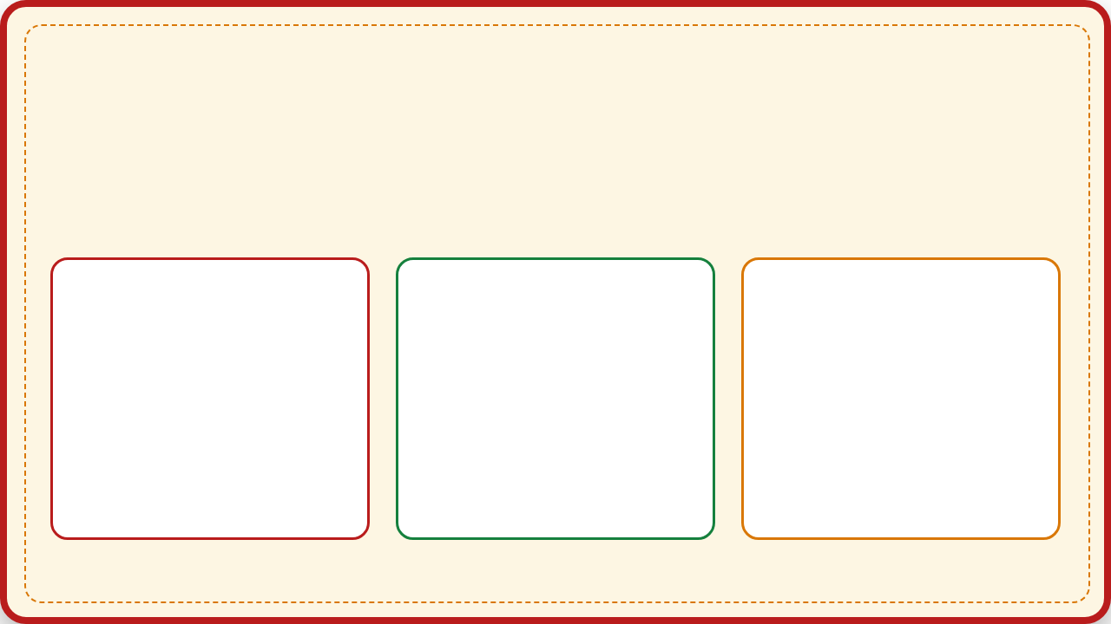







Q1: According to the Chorus...
What three things make the vowels "oh so sweet"?
Option A
Option B
Option C
Height, Frontness, Roundness
Gold, Frankincense, Myrrh
Sugar, Spice, Everything Nice

Slide 4
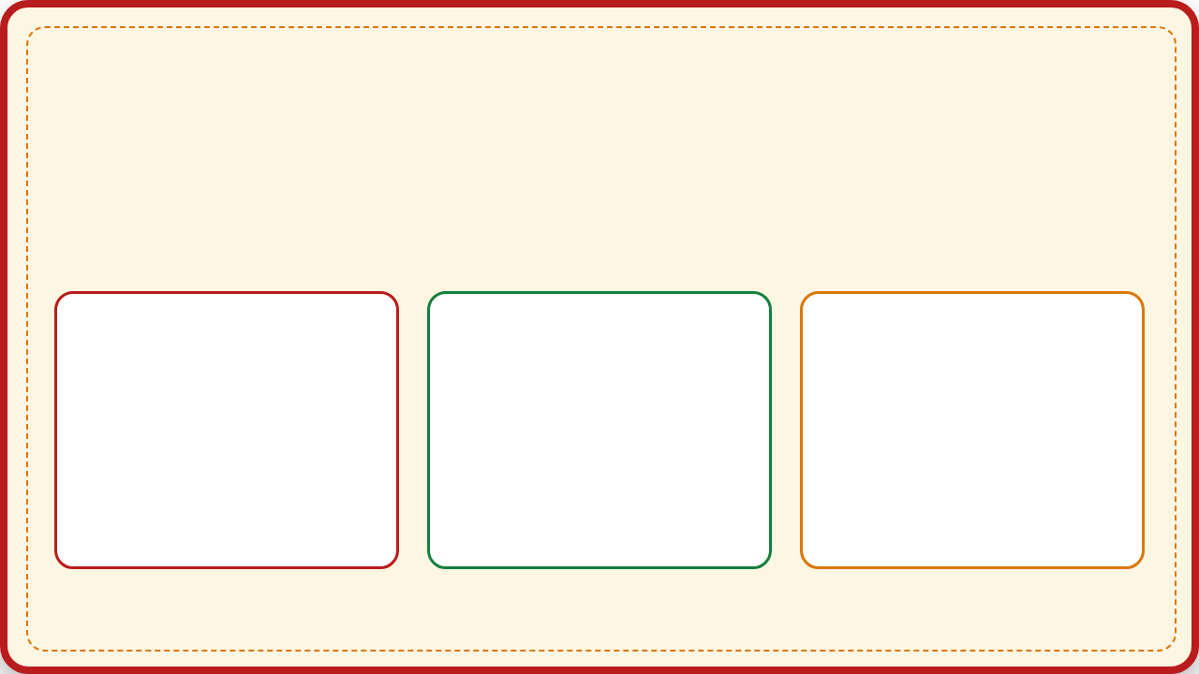







Q2: In Verse 1...
What "Rings the Bell"?
Option A
Option B
Option C
Santa's Sleigh
Manner of Articulation
The Glottal Stop Express

Slide 5




Q3: In the Bridge...
Who or what "paints the sonic loom"?
Option A
Option B
Option C
Phonology
Elf on the Shelf
The Grinch

Slide 6






Bonus Round: Transcription!
Pick the correct American transcription for:
"Christmas"

Slide 7



Santa's Answer Key
Q1
Height, Frontness, Roundness
Q2
Manner of Articulation
Option A
Option B
Q3
Phonology
Bonus
[ˈkrɪs.məs]
Option A (Paints the loom!)
Option 3 (The 't' is silent!)

Slide 8



A Harmony Unknown!
You have completed the beat.
(Please claim your metaphorical candy cane on the way out)

